Slide 1
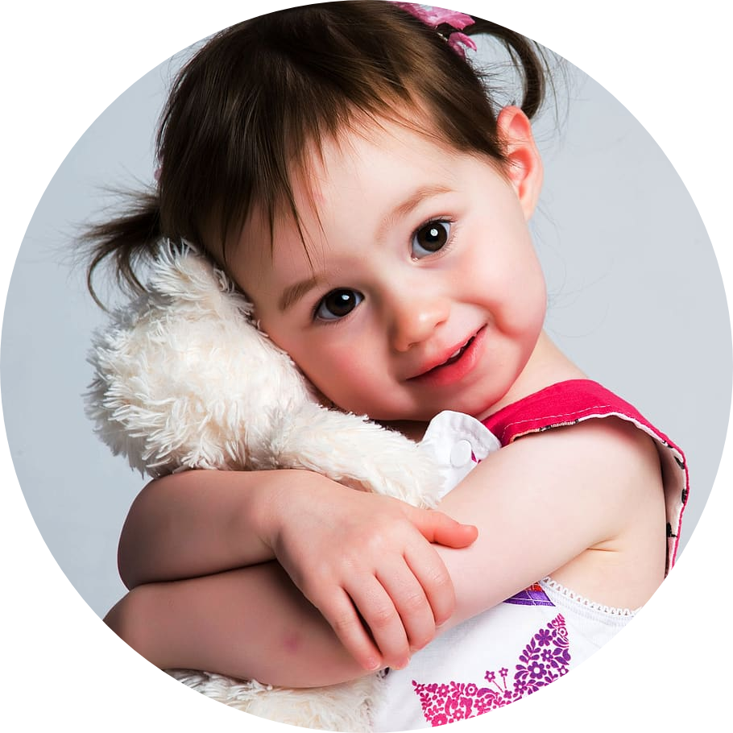
Teach me
“My ability is your disability”
Tasfia Barshat
190042126
Talimul Bari Shreshtho
190042128
Mumtahina Rahman 190042129

Slide 2
Motivation
“Developing an easy-to-use, interactive online learning platform for children with Autism Spectrum Disorder (ASD) along with some treatment exercises to make learning efficient.”

Slide 3

Brief overview
Easy to use platform
Interactive
Learning platform
Children with ASD
Efficient learning environment
Treatment exercises

Slide 4
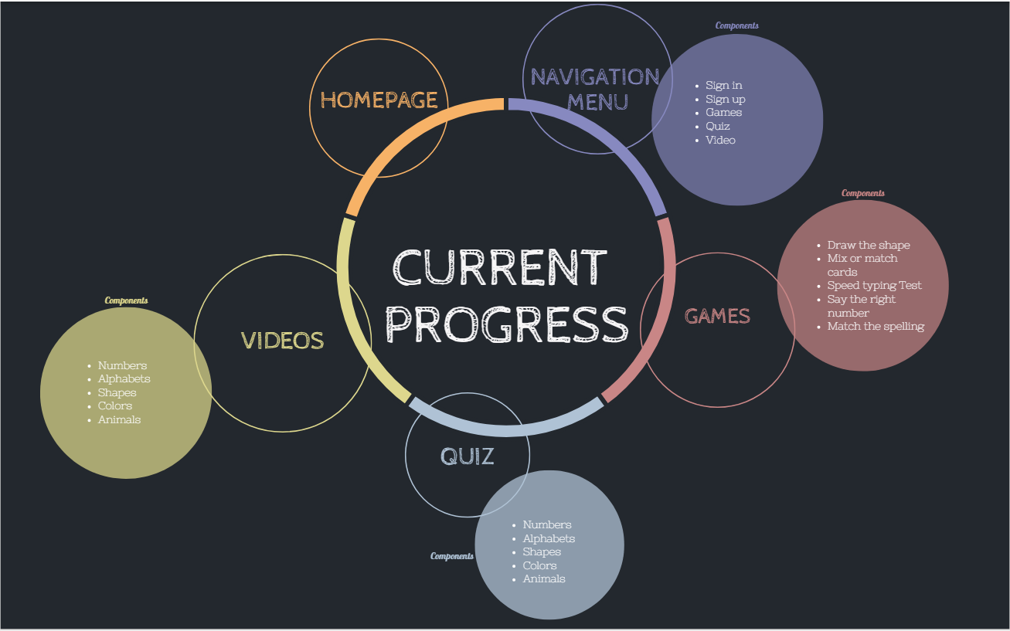
4
4

Slide 5
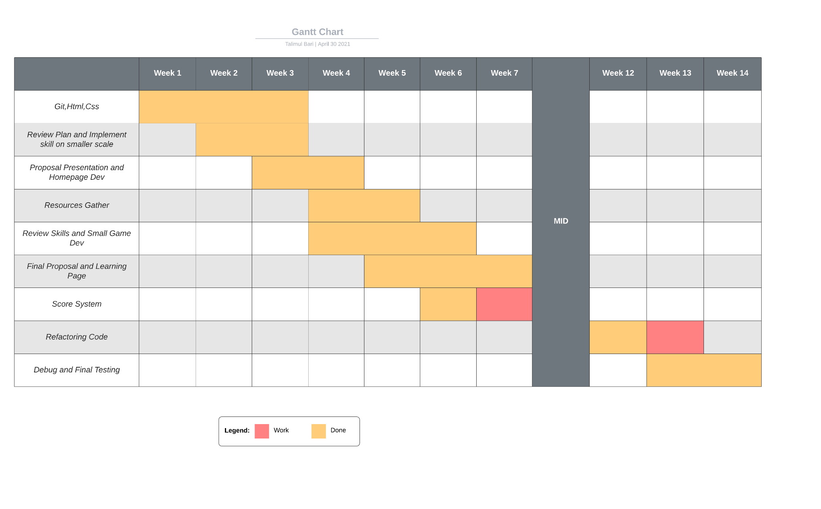
Project timeline

Slide 6
DEMONSTRATION OF PROGRESS

Slide 7


